Slide 1

IS Acquisition, Development & Implementation II
Information Systems Auditing
Class IV

Slide 2
Class Recap

Slide 3
Class Roadmap
IT Governance: Concept
IT Governance: Audit Program
IS Acquisition and Development
IS Implementation
IS Operation & Business Resilience
Protection of Information Assets I
Protection of Information Assets II
Mid-Term Exam
Basic of Data Analysis
Risk and Control
Parallel Simulation
Analytics and Sampling
Substantive Testing: Sales Cycle
Substantive Testing: Expenditure Cycle
Audit Report
Final Exam

Slide 4
Covered So Far
IT Governance in concept
IT Governance through COBIT 2019 standard
Using COBIT 2019 as a criteria for IT Governance Audit
How Systems are Acquired & Developed
Remember, the first half of this class will cover domains in CISA Review, as follows:
IS Auditing Process
IT Governance
IS Acquisition, Development, and Implementation
IS Operations and Business Resilience
Protection of Information and Assets

Slide 5
Fill-up Chapter 3 - reflection
It is not for you to memorize every detail or understand the entire book deeply right now. That is unrealistic.
I expect you to gain a macro perspective—to know the universe of concepts in the domain. Think of it as knowing the map of the knowledge.
The value is knowing where to dig deeper later. When you need the specifics, you should know the correct domain, topic, or concept to search for.
And that actually what school or college is for at the end of the day

Slide 6
Testing Methodologies
Configuration & Release Management
System Migration, Infrastructure Deployment & Data Conversion
Post-Implementation Review

Slide 7
Intro
#test #prepare #move #review

Slide 8
What is it about?
Part B focuses on the second half of the system life cycle — the moment when the system is almost ready, about to go live, and after it goes live.
This section teaches how an organization ensures that the system is:
tested properly,
released in a controlled way,
migrated safely with its data,
and reviewed after go-live.
In short: 👉 Part A is “planning & building.” 👉 Part B is “checking & delivering.”

Slide 9
Why It Matters to an IS Auditor
IS Auditor must understand that most project failures occur not during planning, but during:
testing errors,
poor migration,
uncontrolled releases,
or missing post-implementation evaluation.
Auditors must be able to assess whether:
the system is tested properly,
the release is controlled,
the migration is safe,
and the implementation achieved its goals.

Slide 10
Testing Methodologies
#test

Slide 11
Testing in A Nutshell
Testing is like checking a machine before you sell it
You press every button, try every feature, and see if anything breaks.

Slide 12
Testing Principles
Test early, test often – defects cost more to fix later
Independent testing – separation from development
Expected vs actual results – documented test cases
Negative testing – test what should not work
Traceability – each test case maps to a requirement

Slide 13
Types of Testing - I
Unit test → “check small pieces”
Tests individual modules/functions
Performed by developers
Focus: logic, boundary conditions, error handling
integration test → “check pieces together”
Tests data flow between modules
Ensures interfaces work
Detects module interaction failures

Slide 14
Types of Testing - II
system test → “check whole system”
End-to-end testing
Includes:
Performance testing → “Check how fast it runs.”
Stress testing → “Check how it behaves when pushed to the limit.”
Load testing → “Check how it handles many users or transactions.”
Recovery testing → “Check if it can recover after a failure.”
Security testing → “Check if it is safe from attacks.”
UAT (user acceptance test) → “let users try it”
Users validate the system meets business requirements
Requires signed approval before go-live
5. regression test → “check again after changes”

Slide 15
Technical Test Artifacts
IS Auditor is expected to recognize:
Test plan
Test cases & scripts
Expected results
Defect logs
Test evidence
Approval sign-off

Slide 16
Auditor Focus
Was testing complete?
Was it independent?
Were errors fixed & retested?
Was there formal UAT sign-off?
Are test results traceable to requirements?

Slide 17
Configuration and Release Management
#prepare

Slide 18

This Topic in A Nutshell
Think of this as labeling your boxes properly before shipping so you don’t ship the wrong version or an unfinished version.

Slide 19
Key Concepts
configuration → “settings”
versioning → “which one?”
baseline → “approved version”
release → “send to users”
deployment → “install to production”

Slide 20
Configuration Management Basics
Configuration management ensures the correct version of:
Source code
Libraries
Documentation
System settings
Hardware configurations
Security parameters
CISA wants IS auditor to know:
CMDB – Configuration Management Database
Baselines – approved versions
Version control tools (Git, SVN, etc.)

Slide 21
Release Management Responsibilities
Release management controls how and when updates go to production.
Technical components:
Build management – compiling and packaging
Release approval gates
Deployment automation (CI/CD)
Rollback procedures
Environment separation
Development
Test
Staging
Production

Slide 22
Strict Controls
To prevent unapproved changes:
No developer access to production
Segregation of duties between dev, test, ops
Release notes
Test evidence before release
Change tickets with approvals
Integrity verification (hash checks)

Slide 23
Auditor Focus
Who can change settings?
Are versions tracked?
Is there approval before release?
Are releases tested?
Is there rollback if something fails?

Slide 24
System Migration, Infrastructure Deployment & Data Conversion
#move

Slide 25
This Topic in A Nutshell
Migration is like moving to a new house:
Move your furniture (data)
Make sure nothing breaks (validation)
Ensure the new house is ready (infrastructure)
Check everything fits (compatibility)

Slide 26
Key Steps
pre-migration check → “ready?”
data conversion → “change format”
migration → “move data”
validation → “check data is correct”
cutover → “switch from old to new”

Slide 27
System Migration Concepts
Migration involves:
Application components
Infrastructure
Databases
Interfaces
Security configurations
CISA expects understanding of:
Cutover strategies
Big Bang
Phased
Parallel
Rollback plans (critical exam topic)
Performance tuning during migration

Slide 28
Conversion Approaches
Old System
New System
Direct Conversion
Old System
Parallel Conversion
New System
Old System
New System
Phase-in Conversion
Old System
New System
Pilot Conversion

Slide 29
Data Conversion
Converting legacy data into a new structure involves:
Stages of Data Conversion
Data profiling → analyze data quality
Data mapping → old → new structure
Data cleansing → fix duplicates, missing, errors
Transformation → format/data type changes
Loading → import into new system
Reconciliation & validation → totals, counts, integrity
Controls CISA Emphasizes
Completeness checks
Accuracy checks
Hash totals
Control totals (e.g., number of records)
Reconciliation reports

Slide 30
Infrastructure Deployment
Includes:
Server setup
Network configuration
Security hardening
Patch level validation
Capacity & performance testing
Backup & recovery readiness

Slide 31
Auditor Focus
Was migration planned?
Was data validated?
Are old systems secured after cutover?
Is there a rollback plan?

Slide 32
Post-Implementation Review
#review

Slide 33
This Topic in A Nutshell
Checking if the project achieved what it promised.
This is the after-sales inspection — did the system deliver what the business expected?

Slide 34
What PIR Evaluates
Did the system meet business objectives?
Did it stay within budget/time scope?
Are controls operating effectively after go-live?
Are users satisfied?
Were risks properly managed?
What lessons can be applied to future projects?

Slide 35
PIR Technical Activities
Measuring KPIs and expected benefits
Reviewing defect trends post-launch
Checking actual vs expected performance
Reviewing security issues after go-live
Confirming support & maintenance readiness
Verifying service level agreements (SLA) adherence

Slide 36
Auditor Focus
Was the PIR performed?
Were issues documented and assigned?
Were benefits realized?
Are improvements tracked?

Slide 37
Now, it’s time for….
quiz

Slide 38
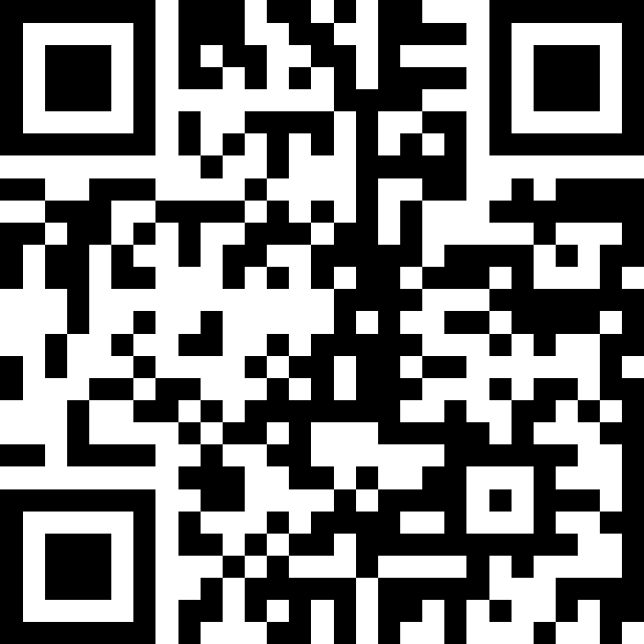
Assignment IV – Give it a rest!
Anonymously, tell me what’s good and what’s not good about this class so far
Post it here:
https://app.sli.do/event/adfxjMGiiT5mQFQpSt18k9

